Slide 1
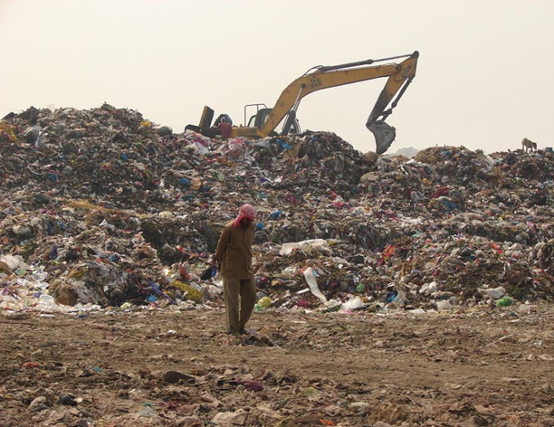


X
Building the capacity of circular catalysts of tomorrow
Kanika Ahuja
Director, Conserve India
President, Plastiskul
kanika@conserveindia.org

Slide 2

Proprietary technologies to create recyclable vegan leather raw materials from “non-recyclable” LDPE plastic waste
Rival the vegan leather industry & grow further to create sustainable home furnishings and construction materials.
Empowering low-income communities to create value from waste
A Circular solution to create materials from LDPE plastic waste
HIGHLY DURABLE, EASILY RECYCLABLE & WATERPROOF
Plastic waste
360+
Tonnes of Plastic Waste Upcycled
Recollect
Upcycled plastic material
3000+
Urban Poor Trained
150%
Income Increase in Urban Waste pickers
Sales
Finished Products
105+
Kgs of CO2 emission avoided

Slide 3
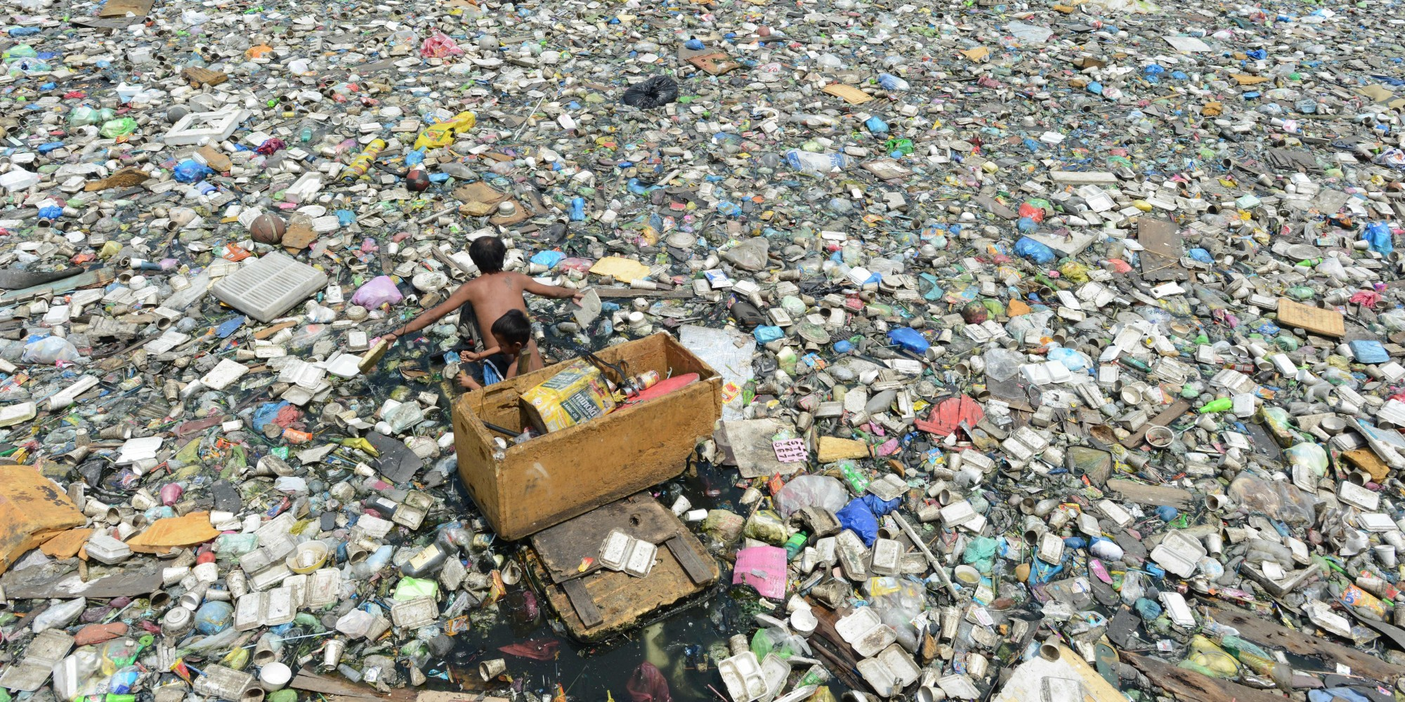

Slide 4

Notes:
There are about 4 million ragpickers in Inda. They are an invisible but integral part of the waste management system in India….

Slide 5
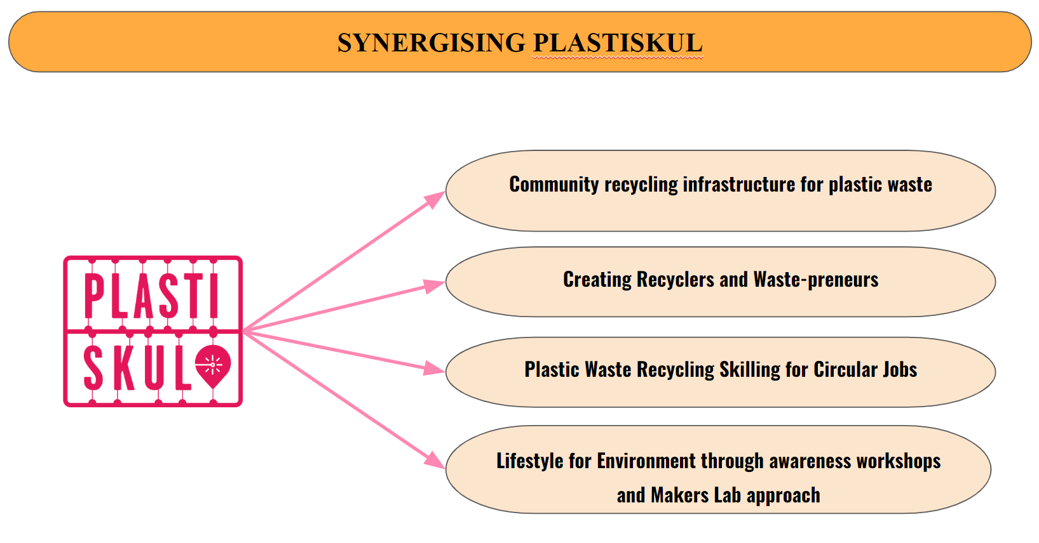

Slide 6

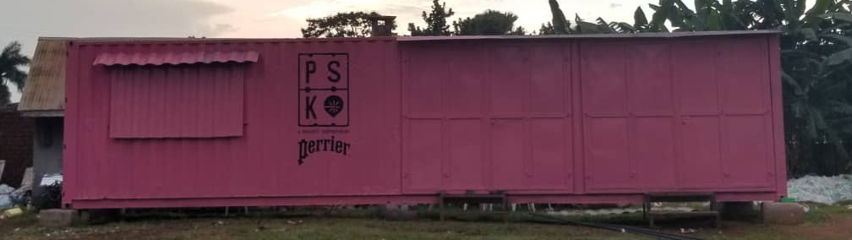







Global consortium spread across 6 countries led by Conserve India
Ability to reuse & recycle multiple forms of plastic waste locally
Reducing the flow of capital and goods through a local circular economy of reuse & recycle
PlastiSkul
Pathway for promoting job creation in circular recycling sector
A Meta-Network of Micro-Factories
Create awareness about anthropologically driven plastic waste globally
Decentralised, customised, innovation-led meta-network of microfactories

Slide 7
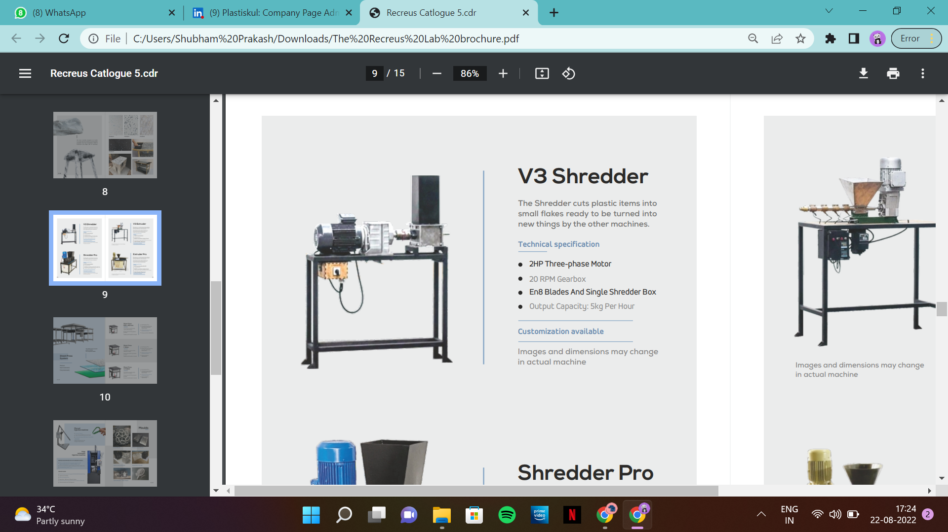
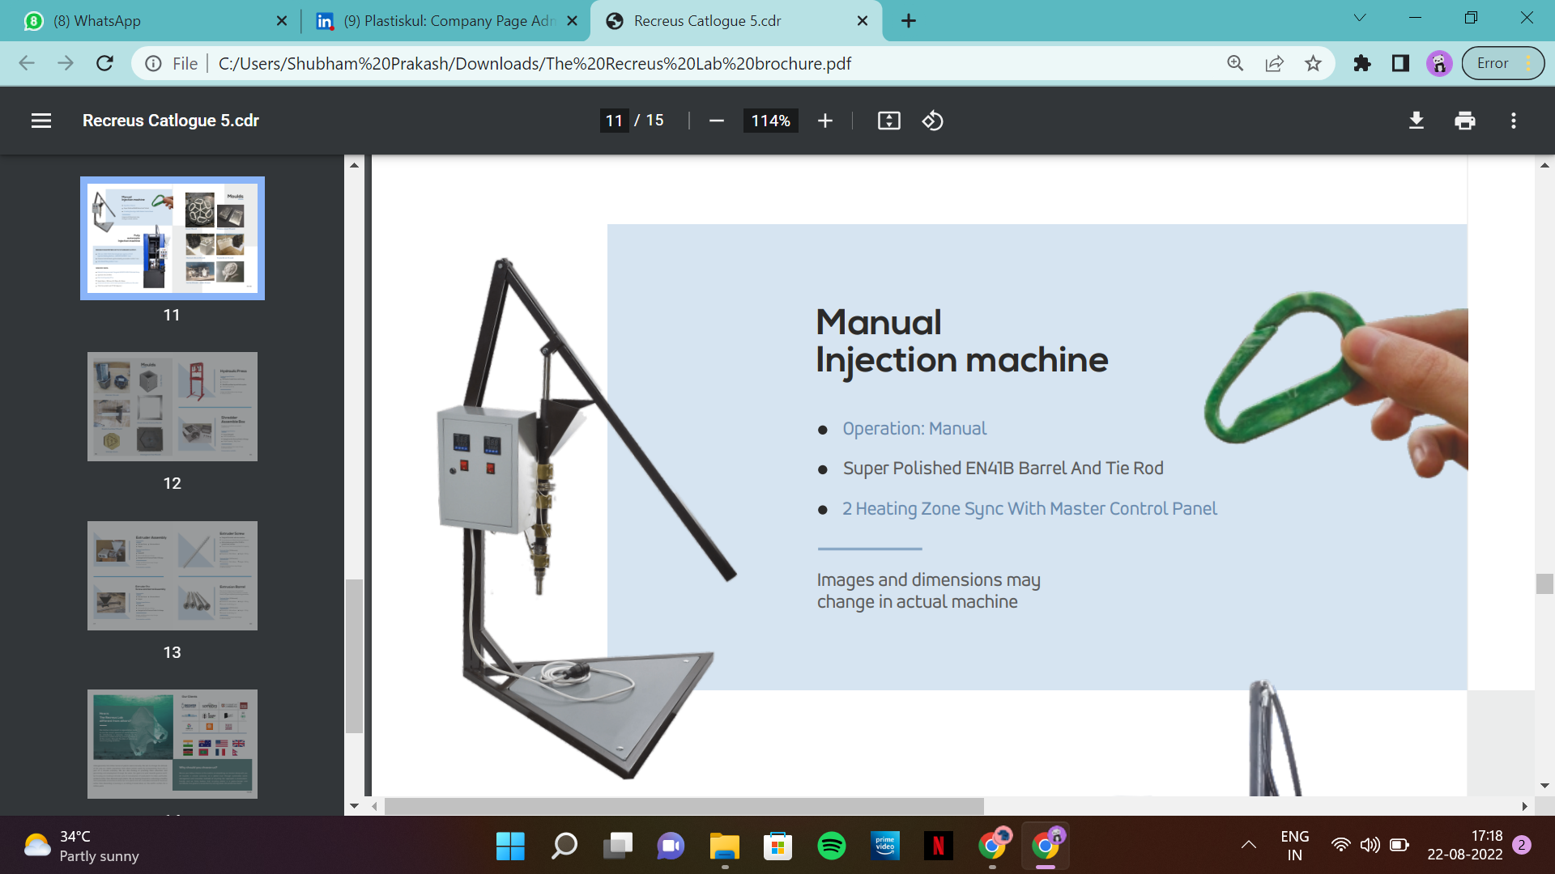
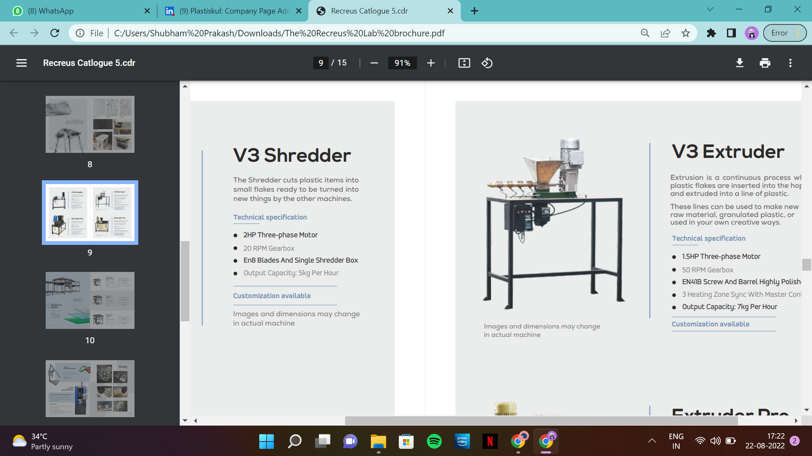
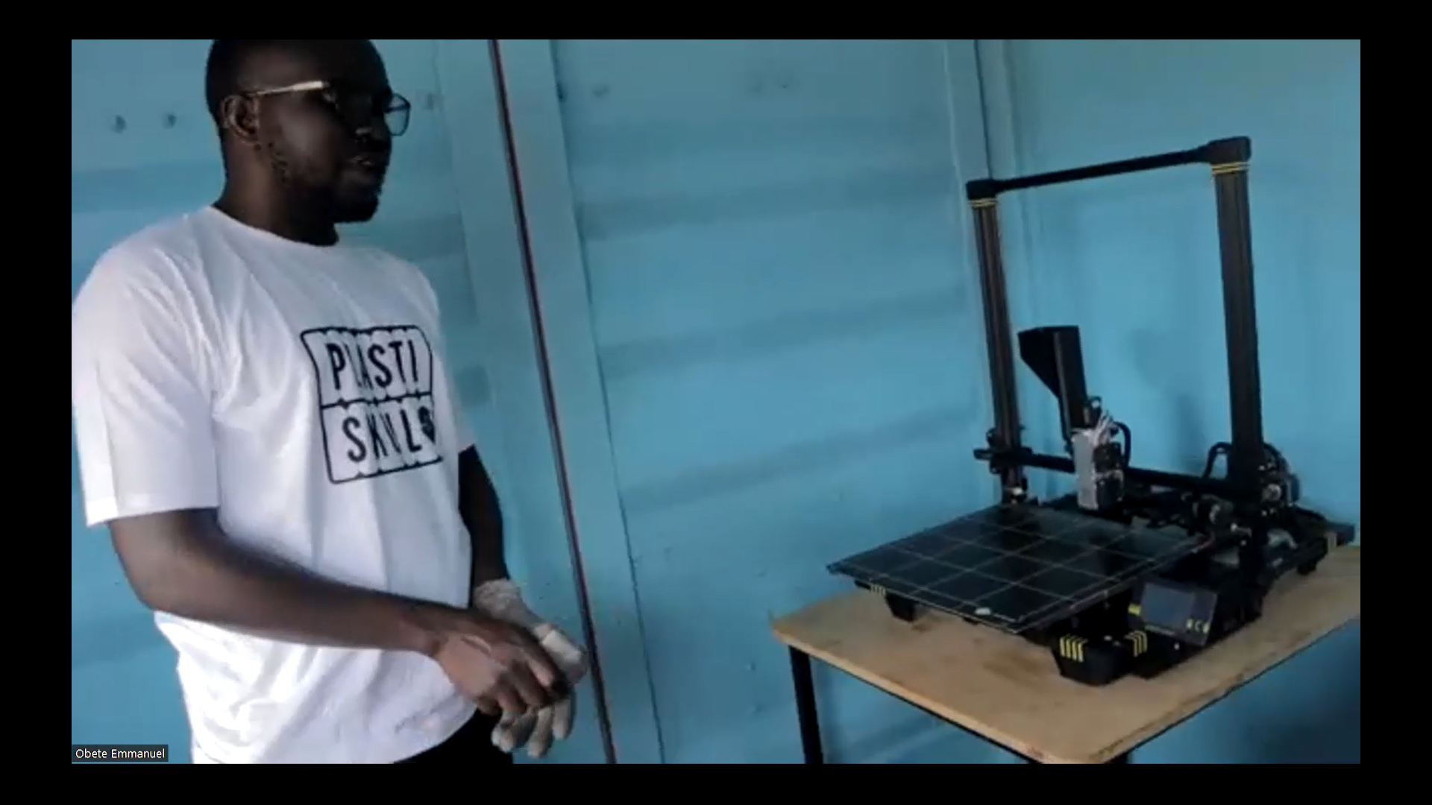
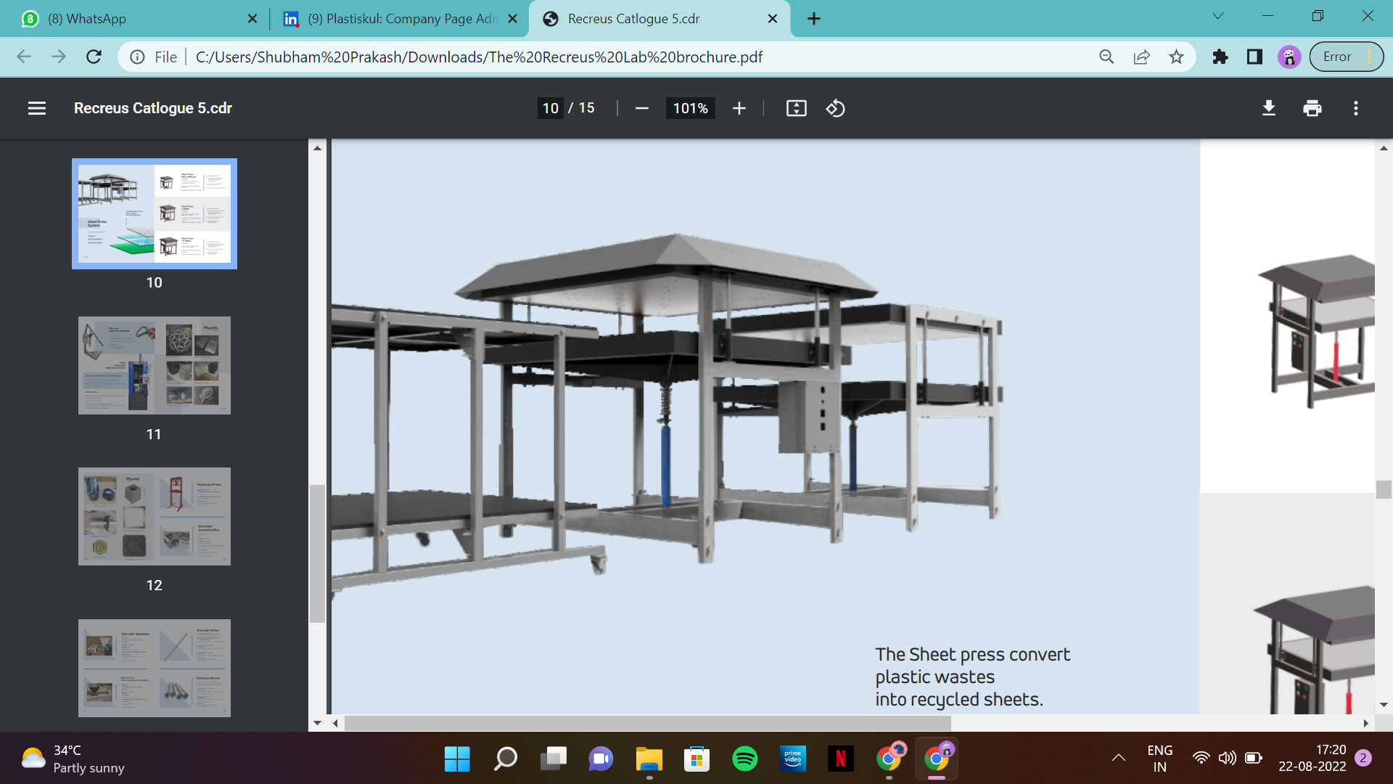
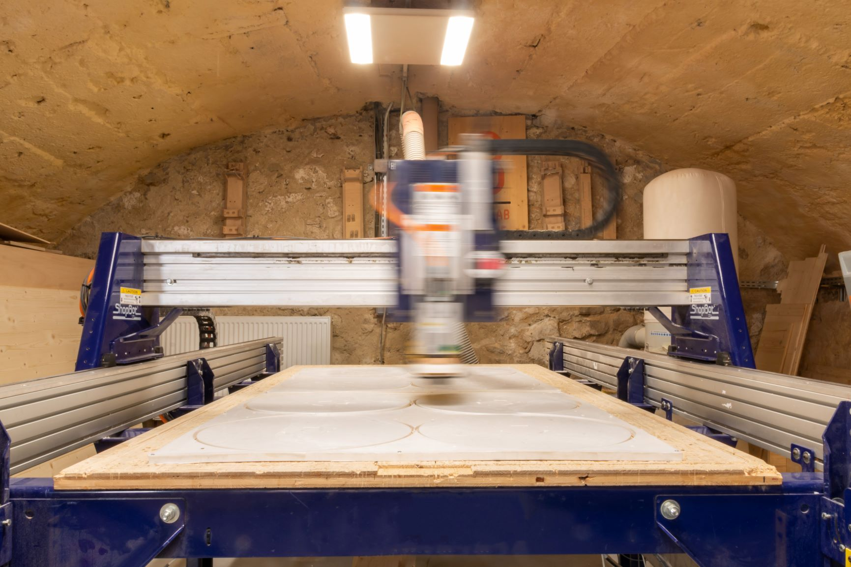
PlastiSkul Technological Scope
CONSORTIUM TECHNOLOGY
‘Handmade Recycled Plastic’ Technology for LDPE waste
‘Biotin’ - Food waste bioplastic
PET waste recycling
Drone Enabled Plastic Waste Collection
FabLab ecosystem
Digital Fabrication & Innovation
Injection Moulding
Shredder
HDPE Waste Shreds
Mould based plastic waste products
Extruder
3D Printer
Products from extrusion of plastic waste
Products using plastic waste as ink
Sheet Press
CNC Router
Sheets from HDPE waste shreds
Product shapes from HDPE waste sheets

Slide 8
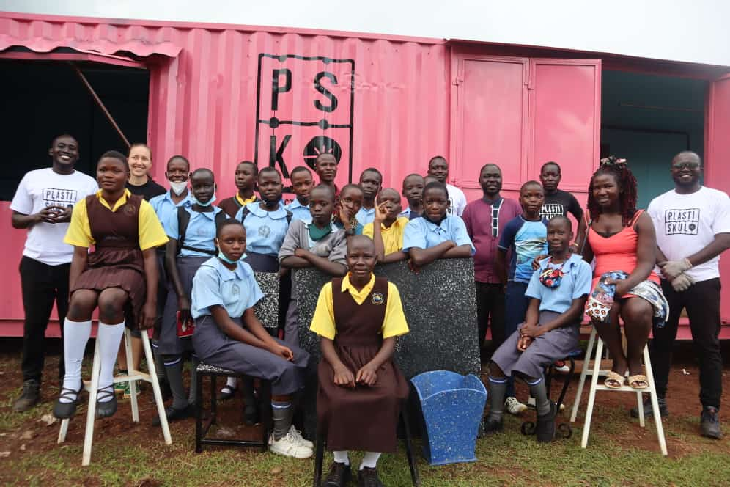
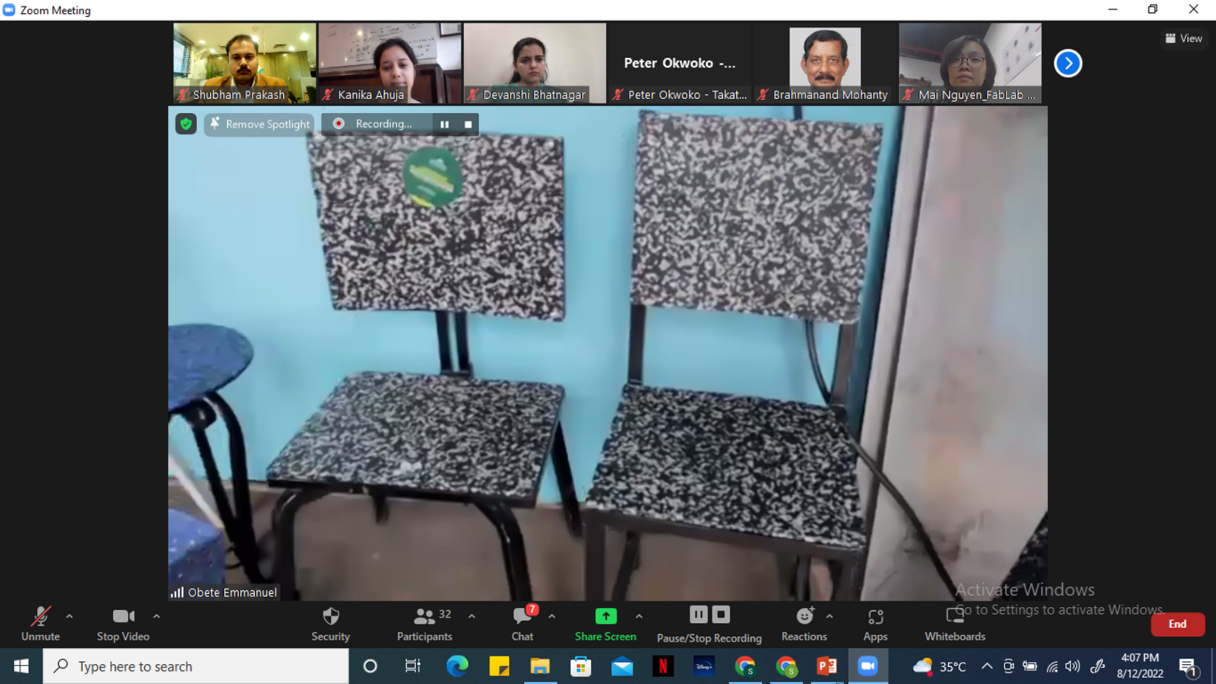
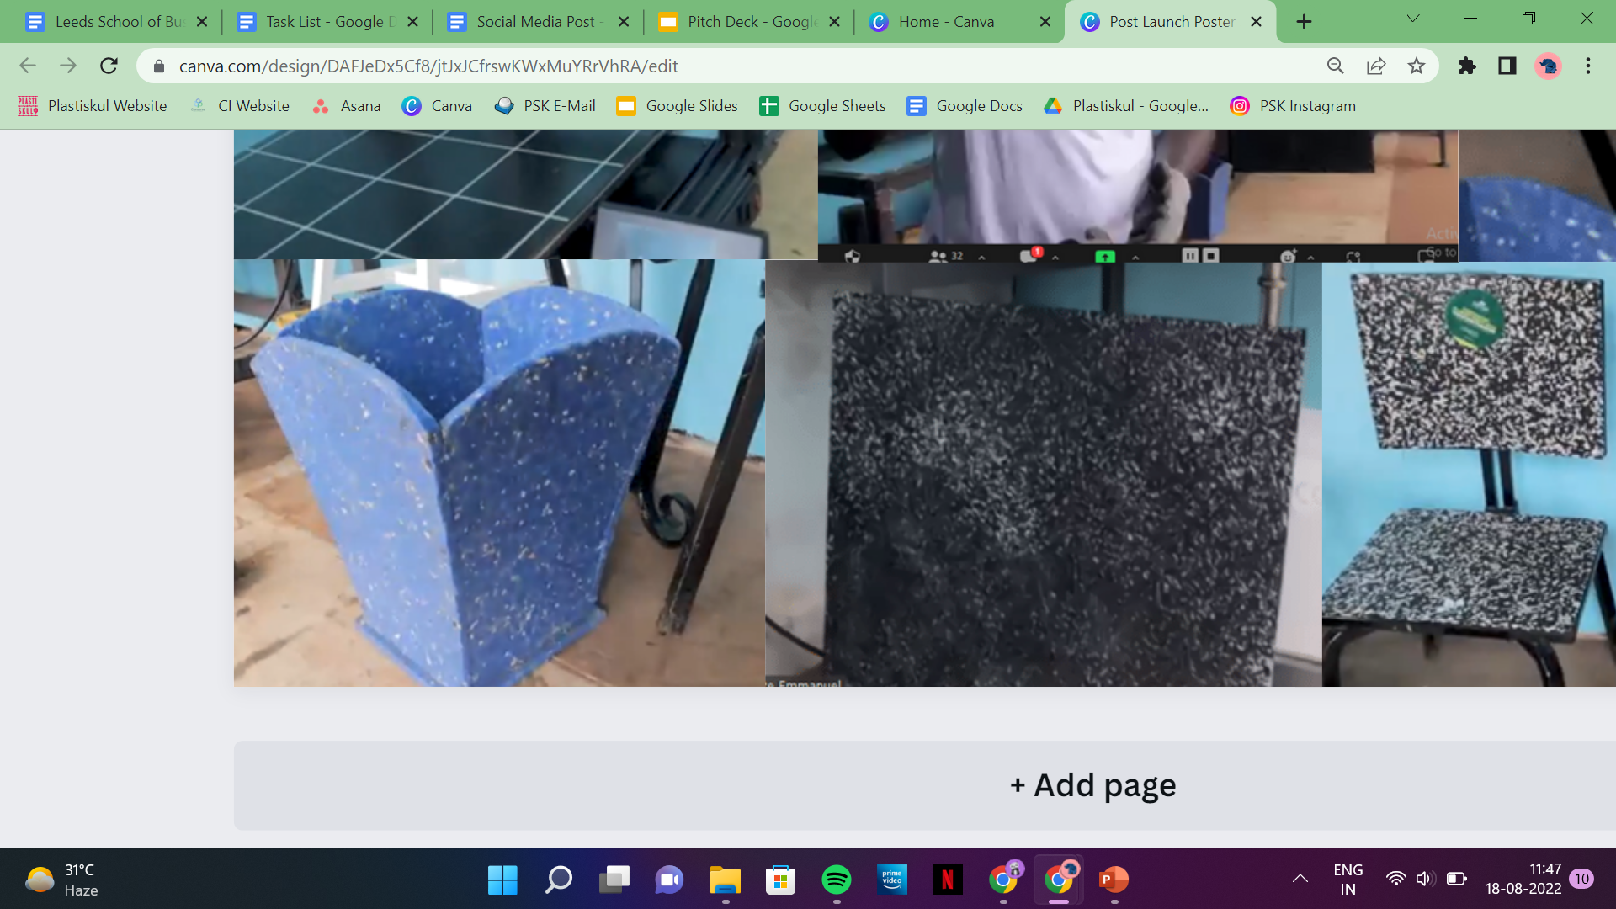
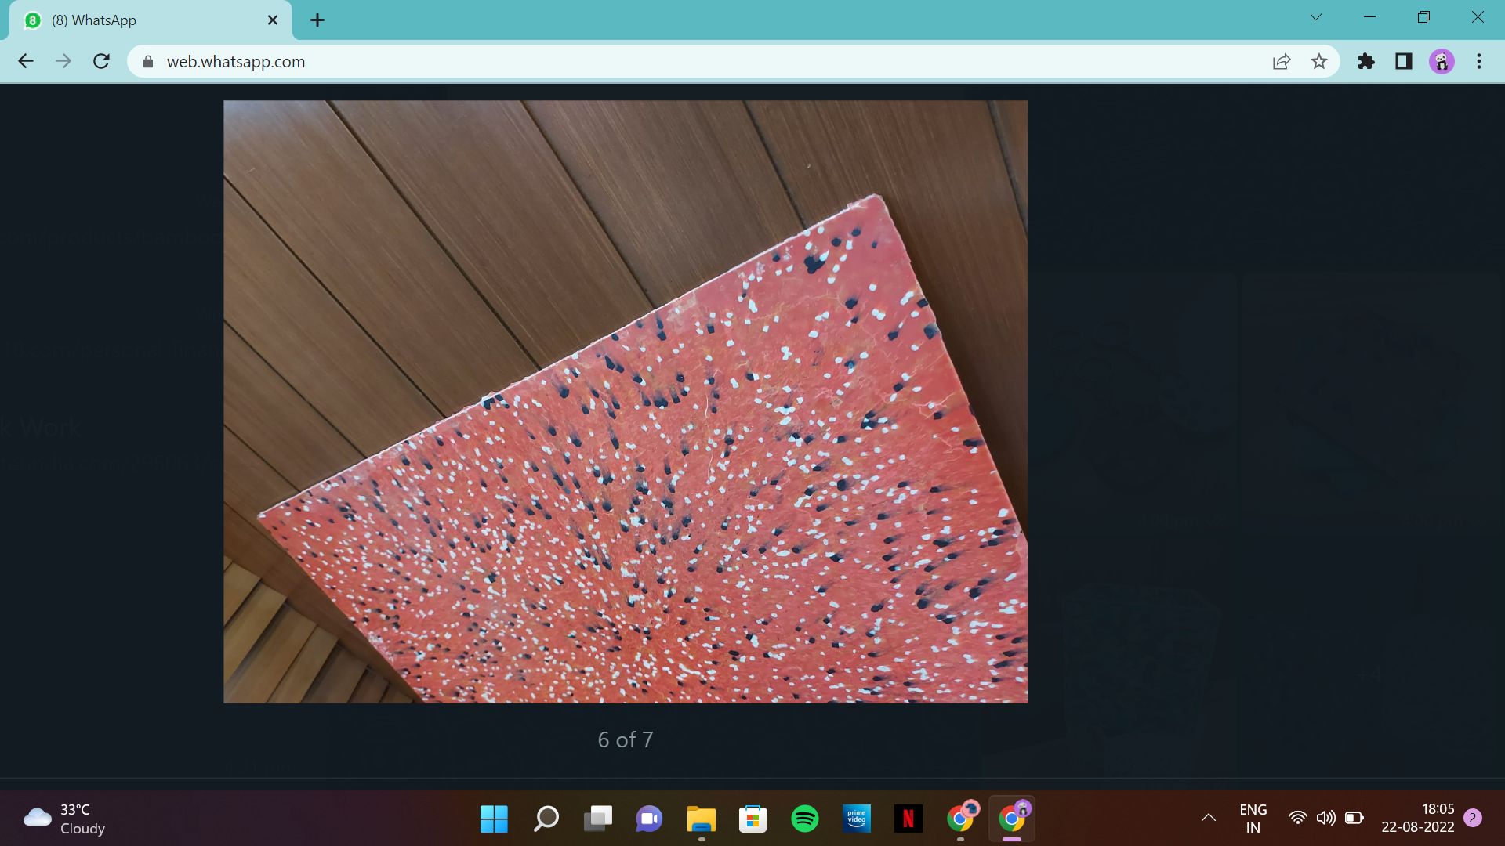
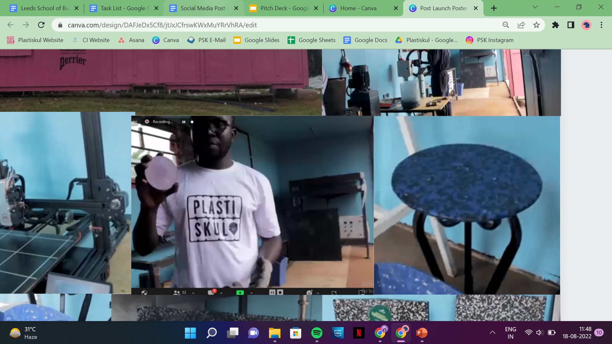
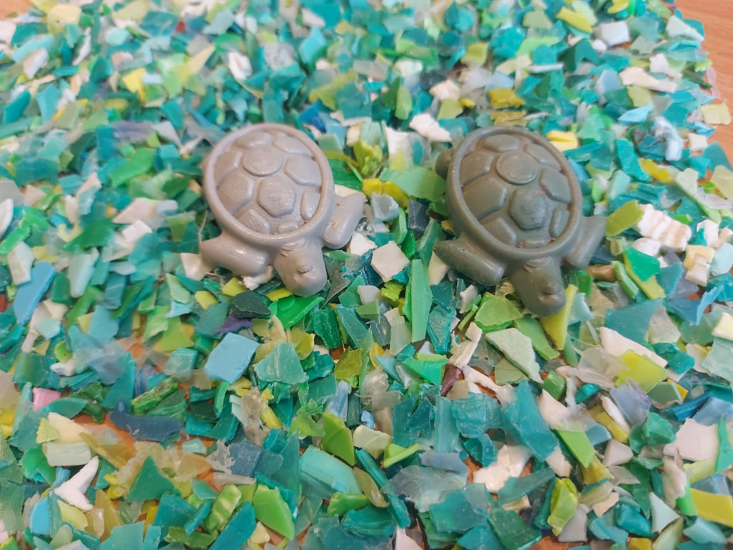
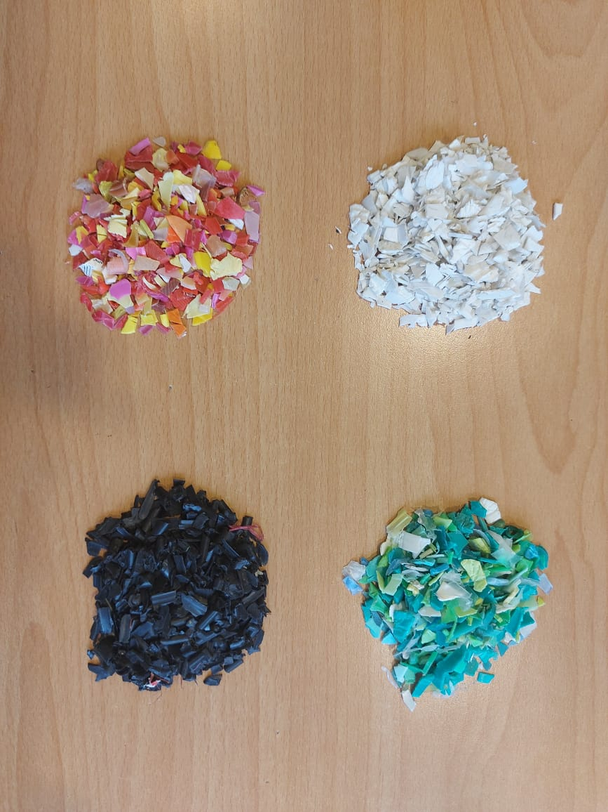
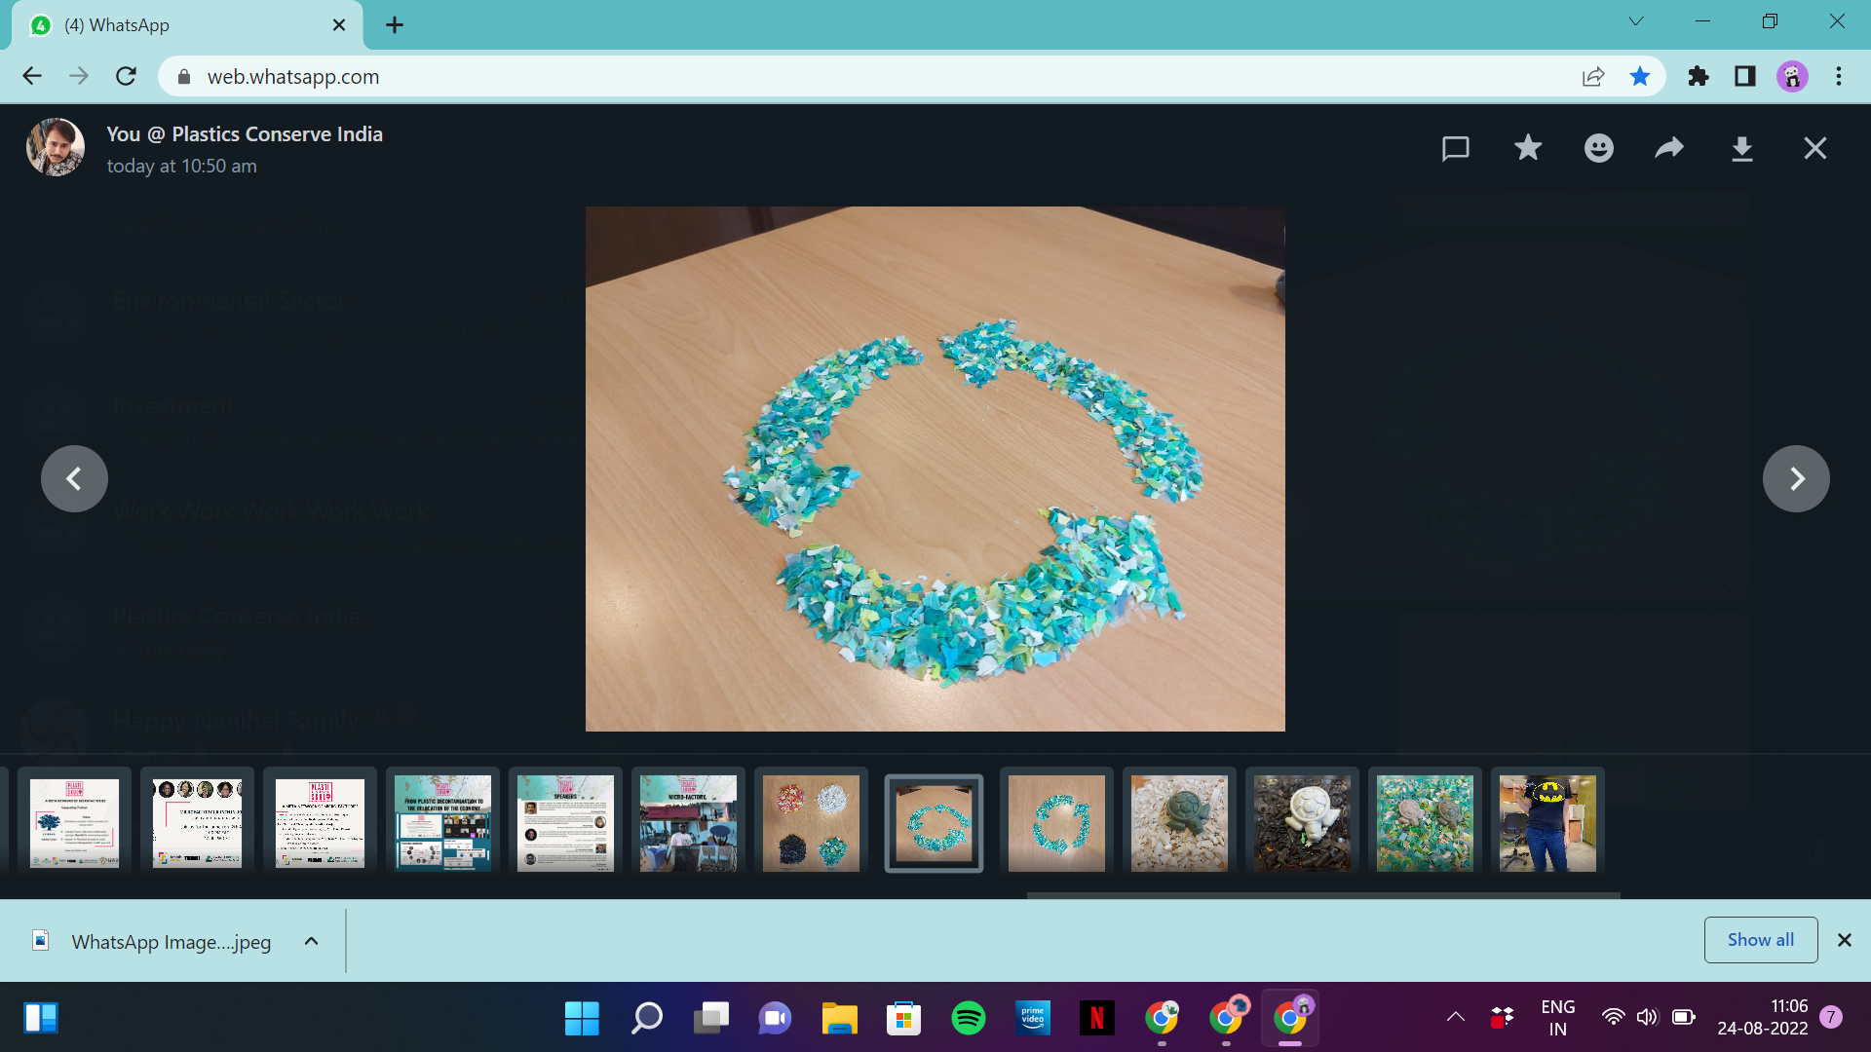
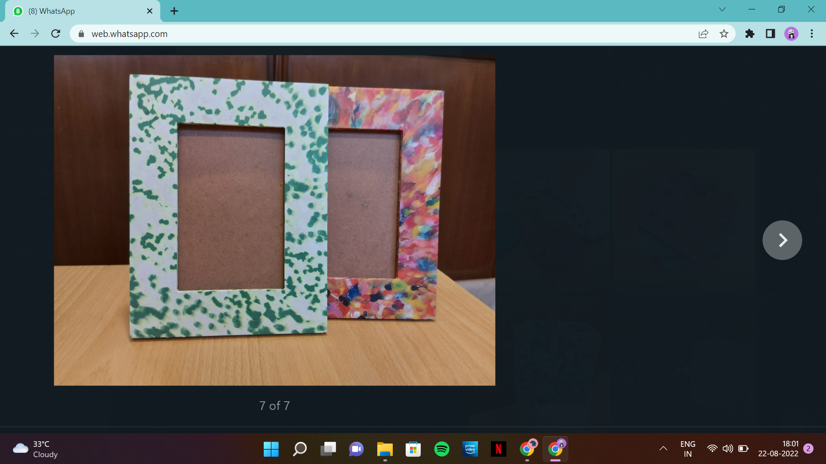
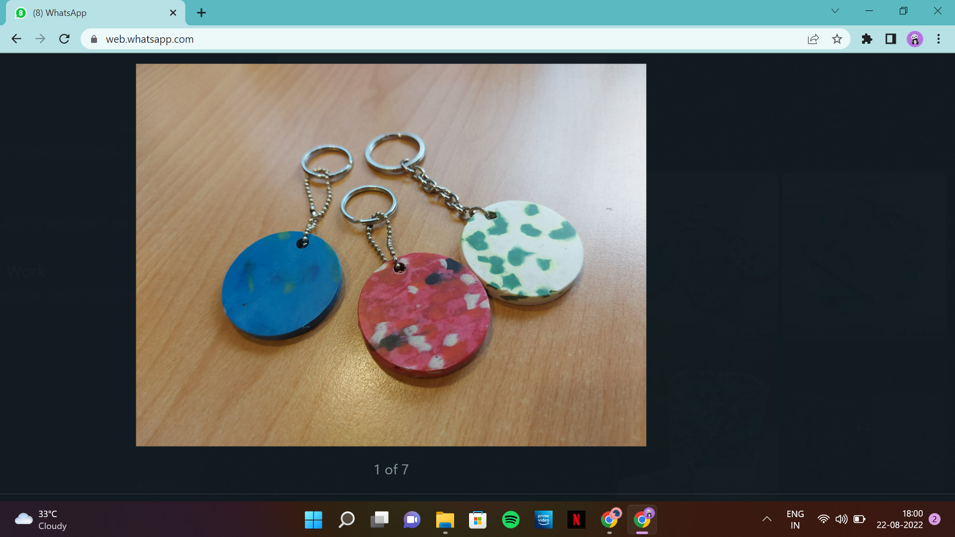
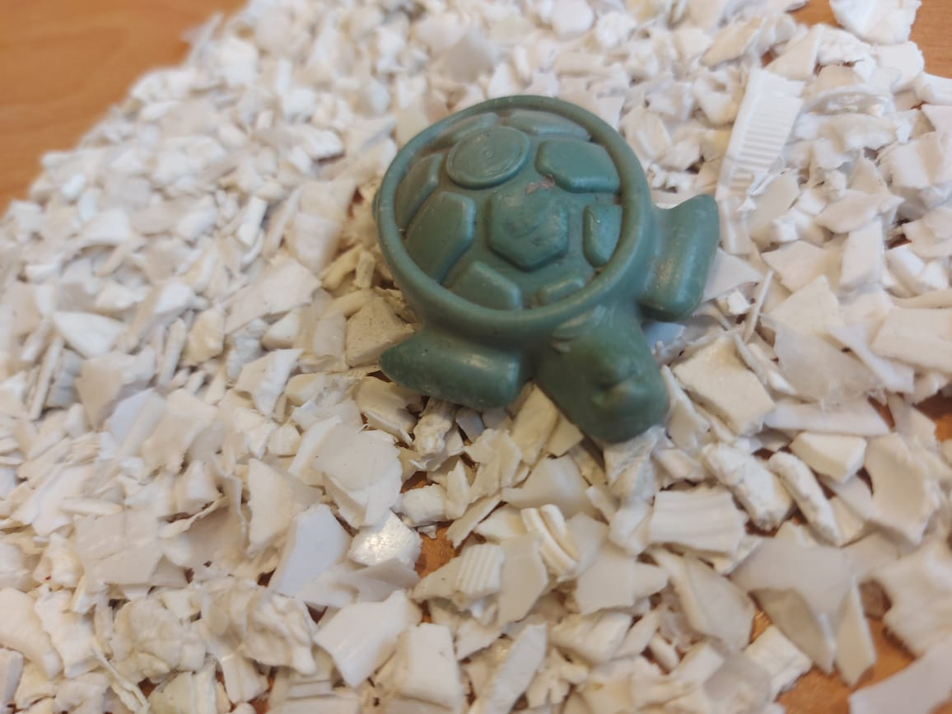
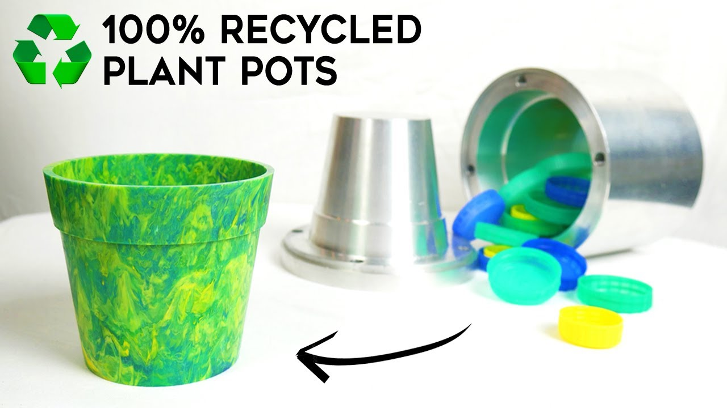
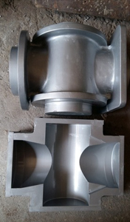
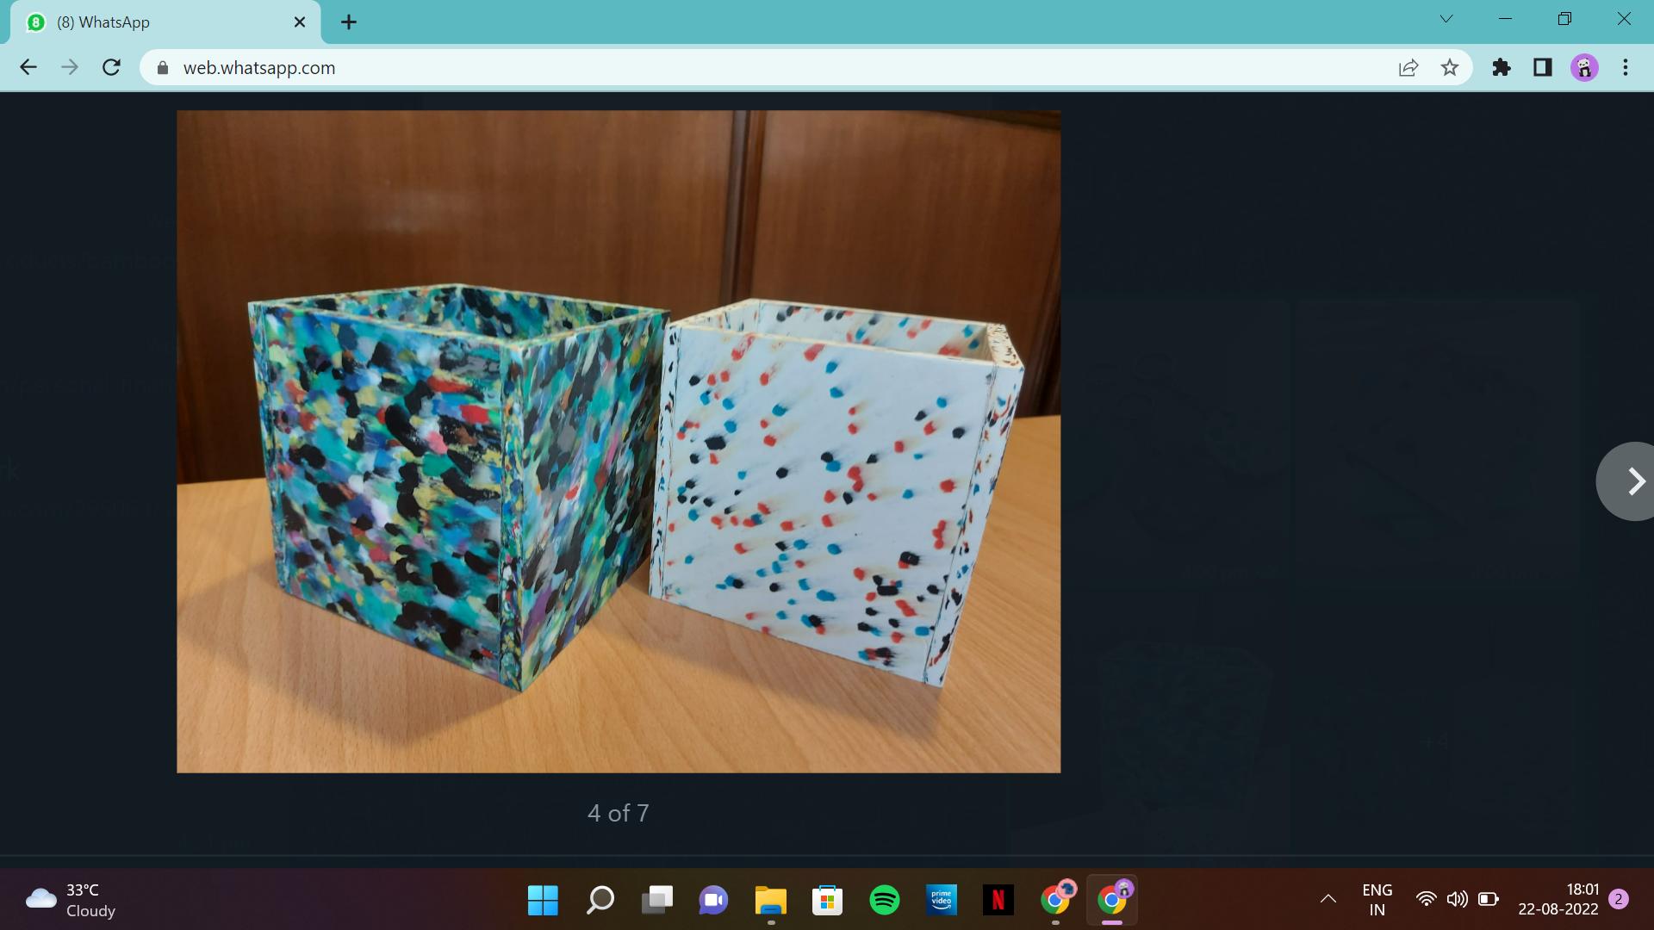
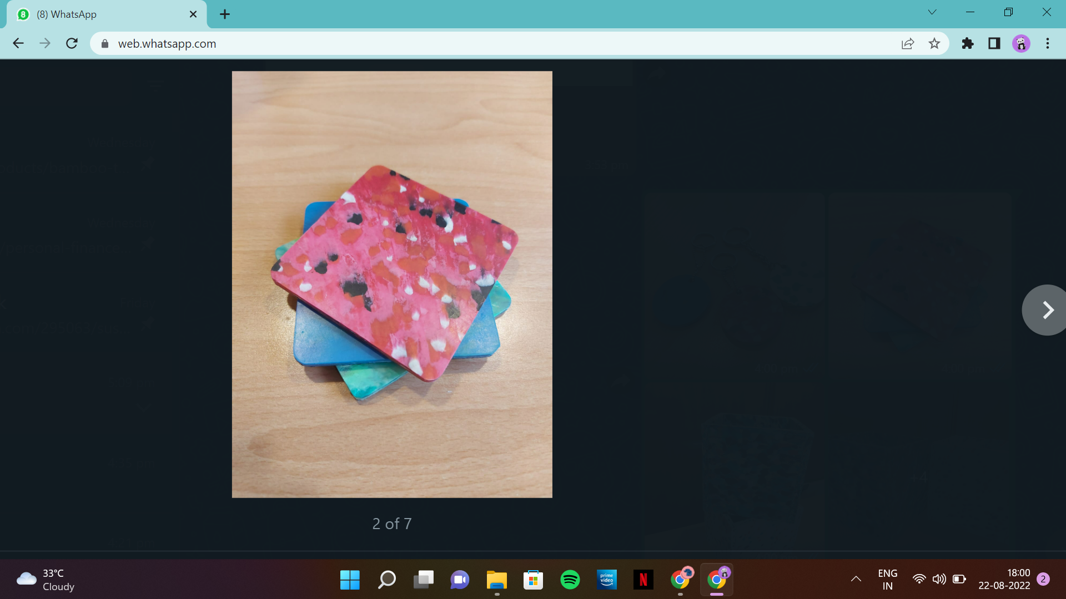
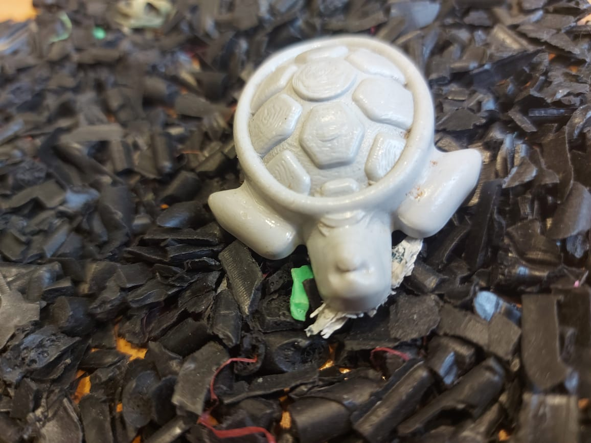
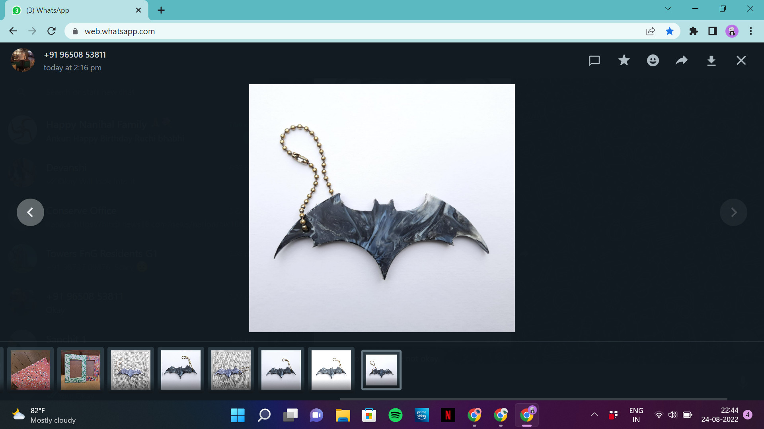

Slide 9







Pilot Projects for Plastiskul
Uganda
India
Plastic Waste Sensitisation & Awareness
Recycling & Upcycling Plastic Waste
School Students Outreach
Recycling & Upcycling generated Plastic Waste
Waste worker upskilling & formalisation
Focus
Focus
School Students reached out for behaviour change, plastic pollution awareness, and sensitisation
Micro-Enterprise for livelihood generation groups under formalisation
2300+
2 x 30
Environmental engineering project to design and execute mobile version of micro-factory
SAP consultancy report on ‘Growth Strategy & Partnership’ across India
Creating volunteer network of vulnerable youths and clean-up campaigns across the city
Conserve India as ‘Industry Partner’, ‘Training Partner’, and Technical Partner’
Youth4SDGs
Creating training courses on recycling technologies

Slide 10
Open for any questions!
X
Know more about us
Plastiskul : www.plastiskul.org
Conserve India : www.conserveindia.org
Follow us on Instagram for Updates
Plastiskul : @plastiskul
Conserve India : @conserve.india

